Slide 1

The Evolution of Search
Where We Are, Where We’re Headed
and Why It Matters
Gillian Muessig – Kharkiv Oct 2011

Slide 2

The King is Dead! Long live the king!
Notes:
The King is Dead! Long, live the King! This refrain rang out from the halls of governing courts around the world for millennia. It still does. It signifies a change that affects all subjects, neighboring countries and sometimes the lives of people halfway around the world It also signifies consistency: the monarchy is not gone. It is changing.
Likewise, in the past months, we have repeatedly heard the refrain, "SEO is Dead!" Most of the pundits fail to continue the refrain... long live SEO - or search marketing.

Slide 3


Notes:
SEO is not dead! It is changing. If it were not, it would, indeed, die. So we should heartened to see the rapid changes as they come. We also need to heed the changes, so we can succeed in the new environments.

Slide 4
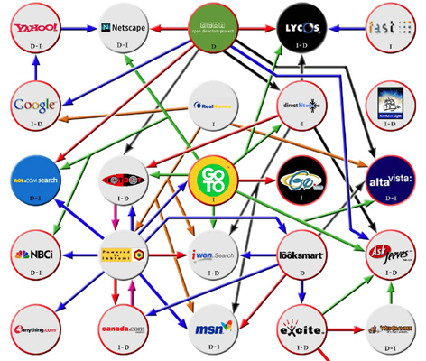
2001: A Crazy Search Landscape
Via Bruce Clay’s classic search engine relationship chart: http://www.bruceclay.com/serc_histogram/histogram.htm
Notes:
In the late '90s and early aughts, search algorithms were just beginning to sort out how to catalog the pages of the web and bring relevant results to searchers. Links were the first powerful signals and they remained so for a very long time. In many respects, they still are powerful - so as we talk about other signals and metrics over the coming days, please don't forget the ongoing power of links or ignore them in your work.

Slide 5
The Algorithm:
(Keyword Use + Anchor Text)
X
PageRank
Simpler times. Spammier times, too.
Notes:
The algorithm was simple. Keyword Use + Anchor Text x PageRank = Success

Slide 6
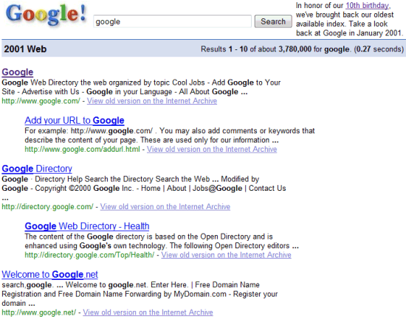
SERPs All Looked Like This:
Via Google’s 10th Birthday post: http://googlesystem.blogspot.com/2008/09/google-time-machine-web-in-2001.html

Slide 7
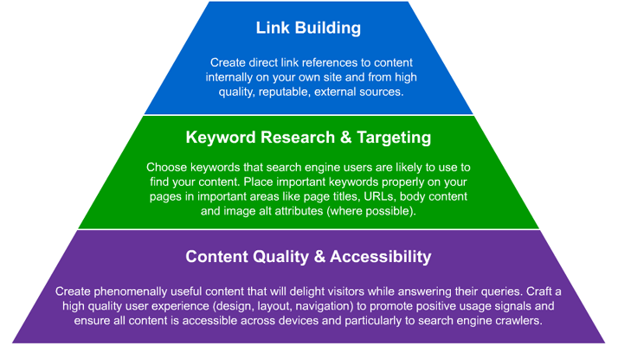
SEO Meant a Few Fundamentals
Make good content, make it accessible, target the right keywords… That was pretty much it!

Slide 8
And a Lot of Link Building
Links were pretty much everything once you got a crawlable, keyword-targeted page set up.
Notes:
But links are a pretty simplistic signal. Unless your name is Rand Fishkin, your Mama doesn't link!
Mamas, in general, don't know how to link. Especially in 2002, they didn't know how. Neither did Grandpapa or your 12 year old niece.

Slide 9
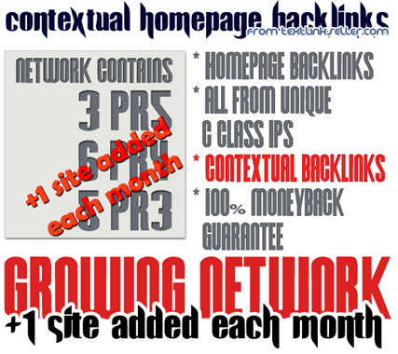
Hello Spam!
Even Rand bought some of these back in the day…
Notes:
Links were easily gamed - we're marketers! We know what to do! So links were created by only a few tech geeks, who pretty much governed the flow of info on the first SERP pages.

Slide 10
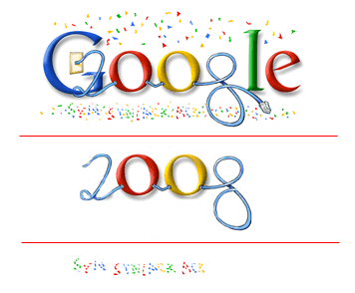
Fast Forward 7 Years
Google celebrated the year with a TCP/IP protocol reference: http://blogoscoped.com/archive/2008-01-01-n53.html

Slide 11
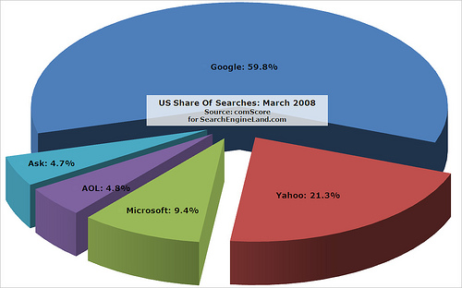
Google’s Dominating
Via http://searchengineland.com/comscore-new-google-high-new-yahoo-microsoft-lows-though-both-rise-in-raw-searches-13784

Slide 12
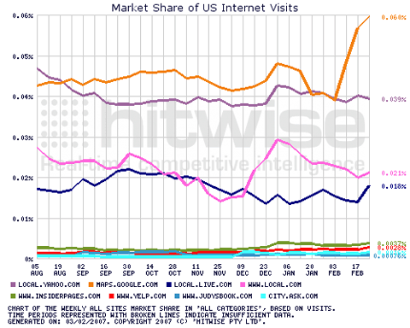
Local/Maps is on the Rise
Matt McGee charted the astounding rise of Google Maps/Local starting in 2008: http://www.smallbusinesssem.com/charting-the-undeniable-growth-of-google-maps/1046/

Slide 13
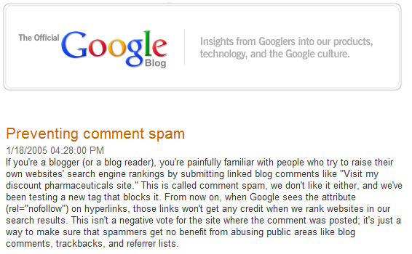
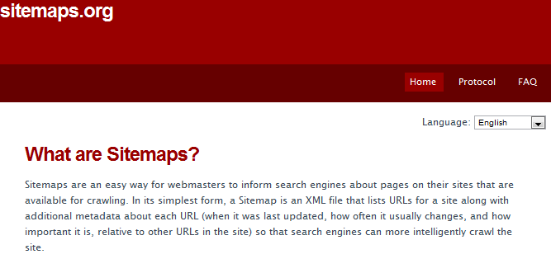
There’s a Few New Protocols
The Sitemaps.org homepage literally hasn’t changed since February of 2008!

Slide 14
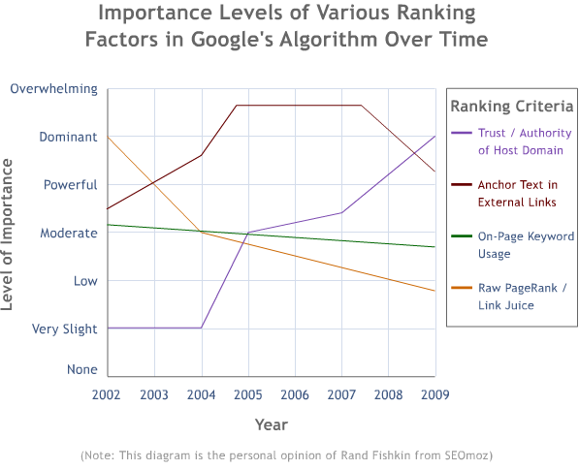
But Not Much Else Has Changed
In early 2009, I wrote a post about the shift in importance of algorithmic factors at Google: http://www.seomoz.org/blog/how-googles-rankings-algorithm-has-changed-over-time-

Slide 15

Jump Ahead… to 2011

Slide 16

It’s a Whole New World
Image via http://gizmodo.com/5478787/the-most-accurate-highest-resolution-earth-view-to-date (which is pretty cool, BTW)

Slide 17
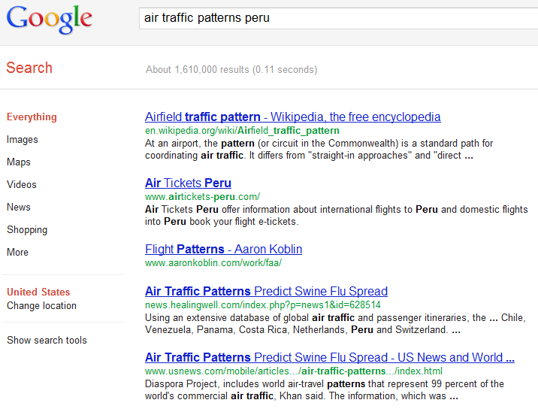
SERPs Rarely Look Like This Anymore
It took me serious time to find a query this sparse

Slide 18
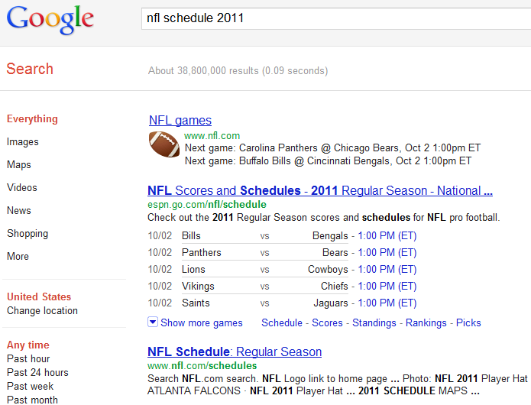
They Look Like This:
Google’s instant answers are getting more detailed and sophisticated, as illustrated by http://www.google.com/search?q=nfl+schedule+2011
Notes:
These days, SERPs look dramatically different. Search for a sports schedule and you’l get the schedule right in the SERP results – a no-click fulfillment of your search request. Talk about instant gratification!

Slide 19
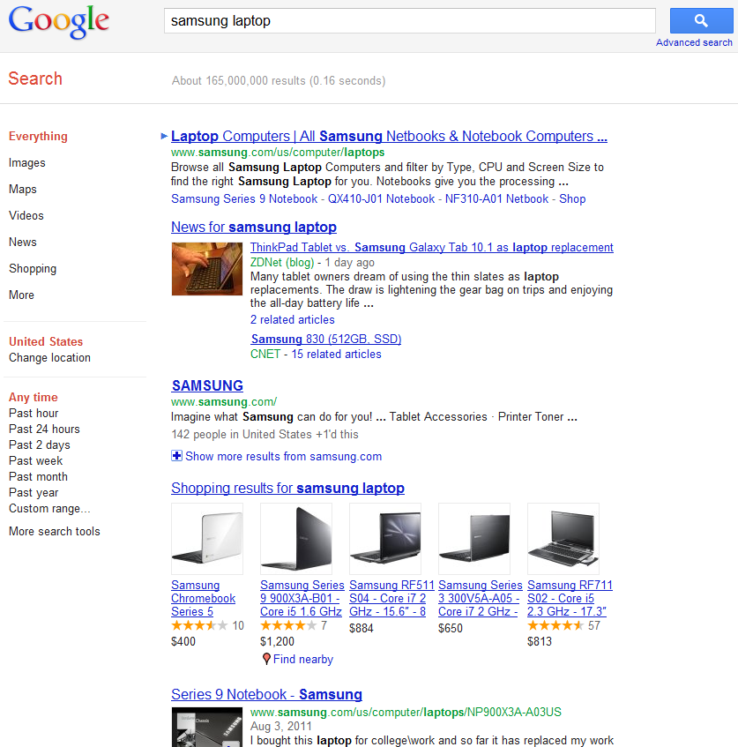
And This:
News results, shopping results and video snippets + the new, shrunken sitelinks for the top result
Notes:
If you’re looking to buy a laptop, you’ll find video, images, and prices in your results. Local search offers one of the most dramatic changes to the SERPs. 7-packs and 10-packs may push all other results below the fold. Maps are clickable to get instant directions, all while keeping you on Google properties.

Slide 20
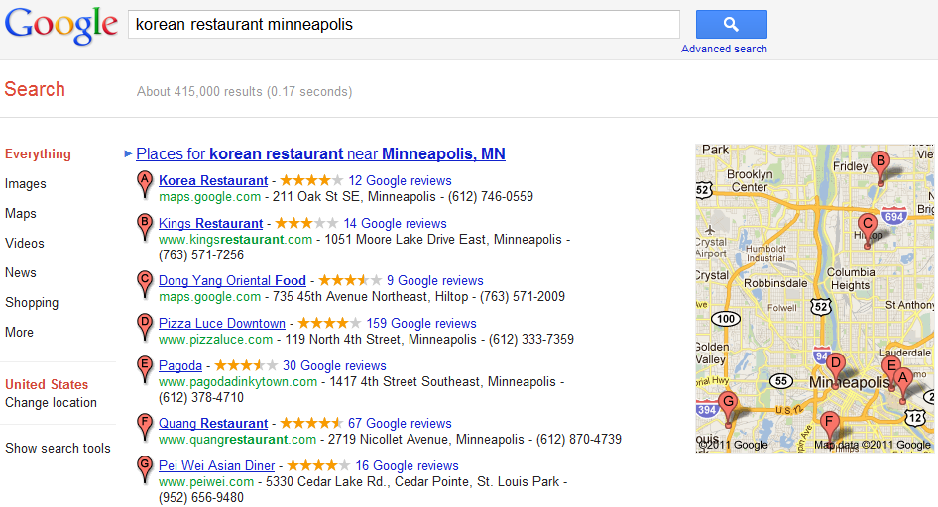
And This:
Awesome!
Notes:
Looking for a restaurant? Personalization and social sharing dominate pages when you’re logged in. And they’re auto-geo-located – again, so long as you’re logged in.

Slide 21
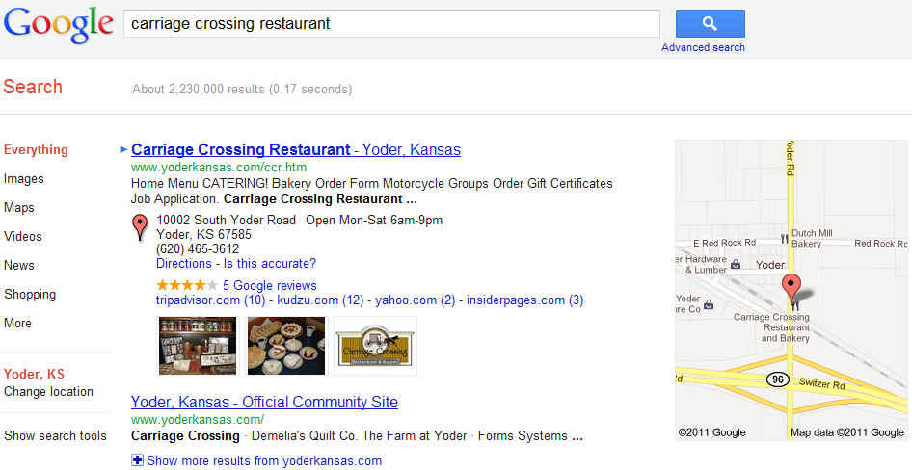
And This:
Personalization and social sharing dominate the page because I’m logged in.

Slide 22

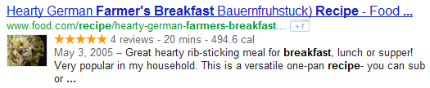
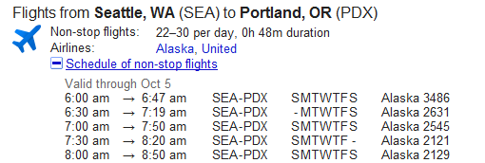
Rich Snippets & Schema.org
There’s a good post by Rich Baxter on Schema here: http://www.seomoz.org/blog/schemaorg-a-new-approach-to-structured-data-for-seo
Notes:
Rich snippets provide ever more information to searchers without so much as a click. Check out Rich Baxter’s excellent post on Schema.org here: http://www.seomoz.org/blog/schemaorg-a-new-approach-to-structured-data-for-seo

Slide 23
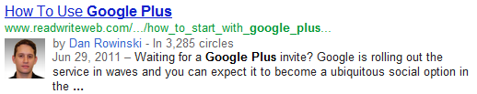
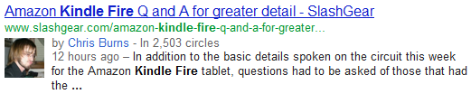
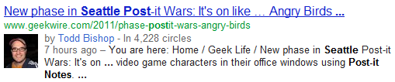
Rel=Author
Good advice on how to get it set up here: http://www.blindfiveyearold.com/how-to-implement-rel-author
Notes:
Where there used to be rel=canonical, we’ve got rel=author

Slide 24
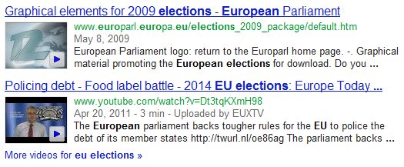
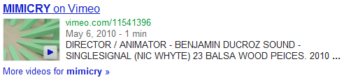
Video Results
Google on how to create video XML sitemaps and appear in these results: http://www.google.com/support/webmasters/bin/answer.py?answer=80472

Slide 25
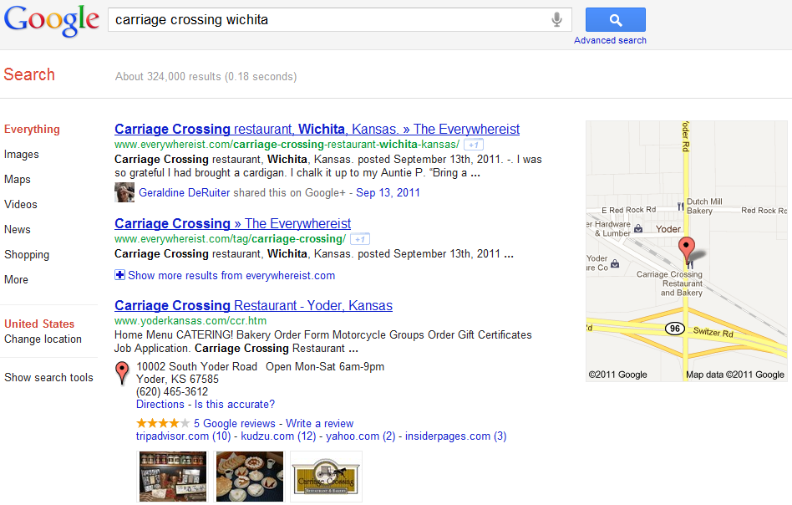
And Social Annotations
Not only are the results annotated with the share / social data; they also outrank the top result
Notes:
Results annotated with share and social data outrank the otherwise top results.

Slide 26
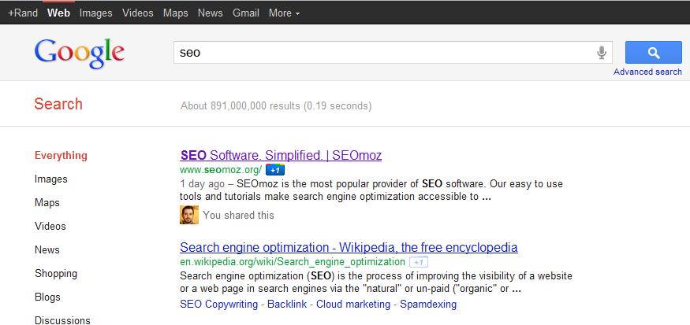
SERPs Are Almost Always Personalized
Search history, social networks, previous clicks and more impact personalization + rankings

Slide 27
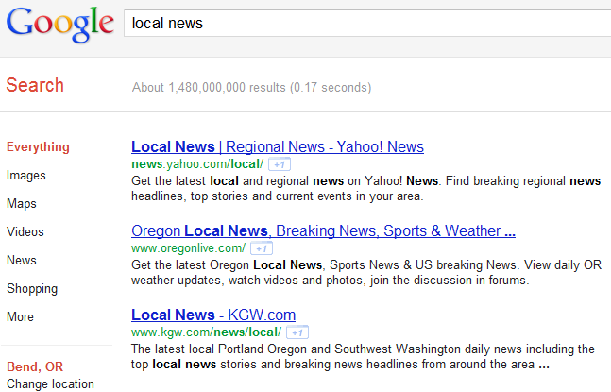
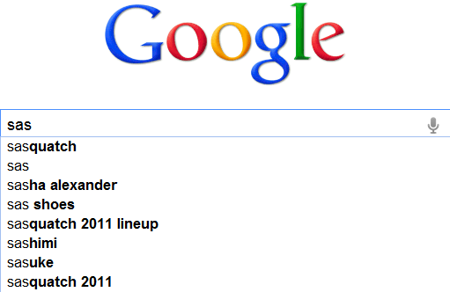
And Geographically Biased, Too
Geography impacts both search result ordering and search suggestions/instant

Slide 28
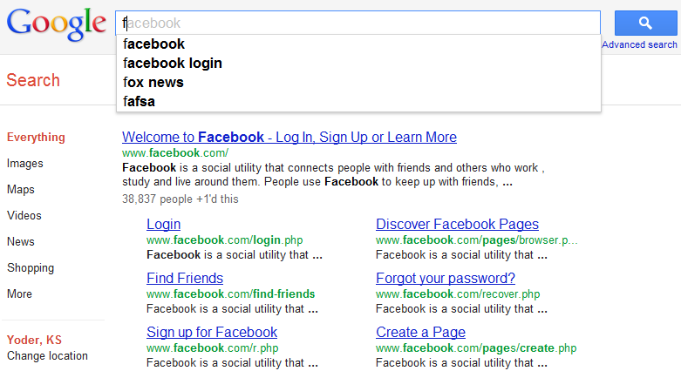
Search Barely Requires Typing
BTW – I tried this same search from Portland vs. Yoder, and “Fox News” is not a top suggestion, but “Firefox “and “Fred Meyer” both are ☺
Notes:
These days, searching barely even requires typing. Type the letter “f” and the word “facebook” is likely to pop up. Keep typing letters for some other word and more options appear. You can select your choice anywhere along the process. This presents a serious challenge to marketers. Since the suggestions presented as we search are based on what we searched for and selected previously, in order to be part of this new drop-down suggestion pack, marketers must get attention on the very first visit or risk not being in the drop-down pack the next time the searcher returns for more research.

Slide 29
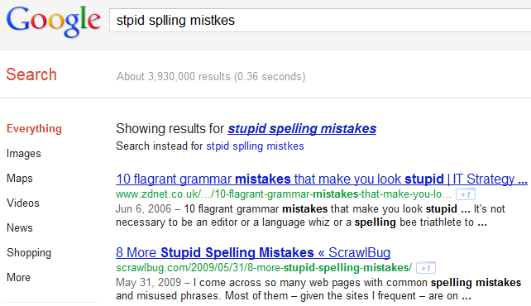
Misspellings are a Thing of the Past
A few years back, there would be entire sessions at conferences on SEO for misspellings
Notes:
Even misspellings are a thing of the past. A few years ago, entire sessions were devoted to tactics for leveraging misspellings. Today, if you – or your searchers - can’t spell, don’t worry! Google will automatically correct you and offer you options to search for correctly spelled products and ideas. Perhaps Google will do what no language teacher has been able to do – teach us all to spell properly every time!

Slide 30
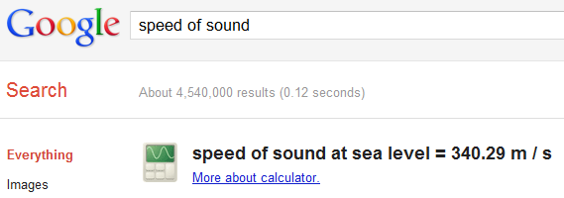
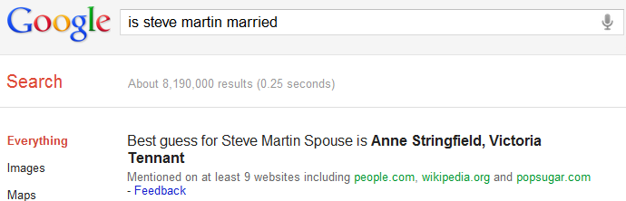
Instant Answers are Everywhere
Google even offered instant answers as to the sexual orientation of celebrities: http://gawker.com/5844769/google-will-now-tell-you-which-celebrities-are-gay (but the feature appears to have been removed)
Notes:
Instant answers are everywhere. No longer do we build long pages of content for information that searchers will be able to get without clicking through to any site. As marketers, we have to stay much more focused now. Google’s answer and “best guess” results trump all other listings.

Slide 31
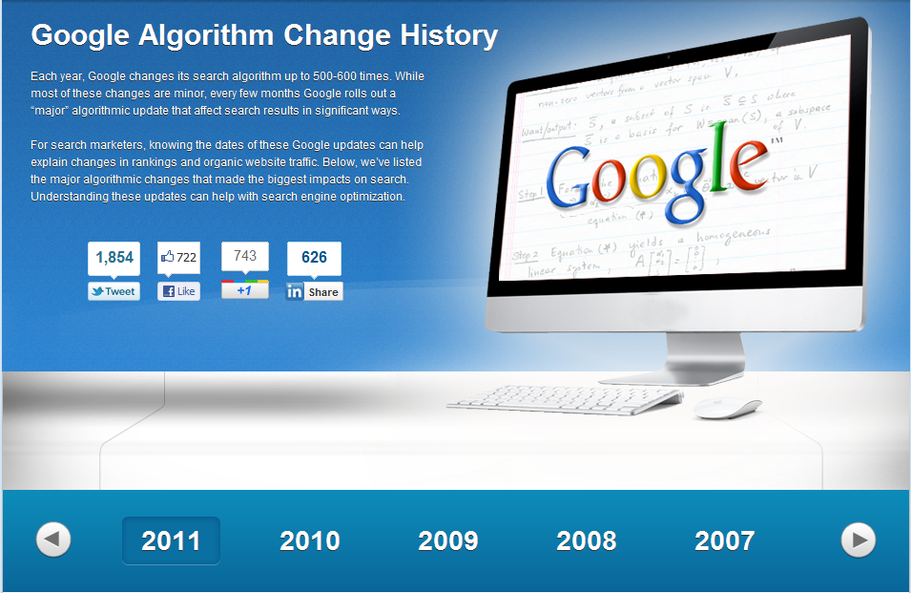
The Algorithm Has Changed
Check out Dr. Pete’s Algorithm History guide: http://www.seomoz.org/google-algorithm-change

Slide 32
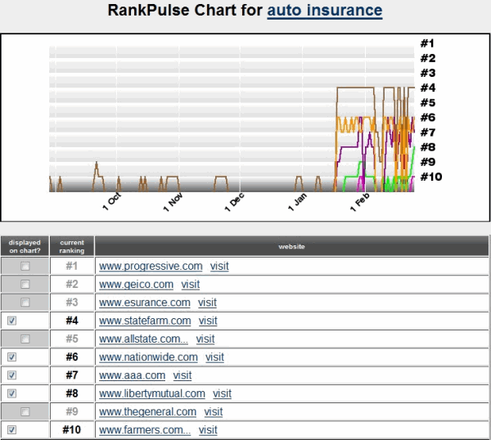
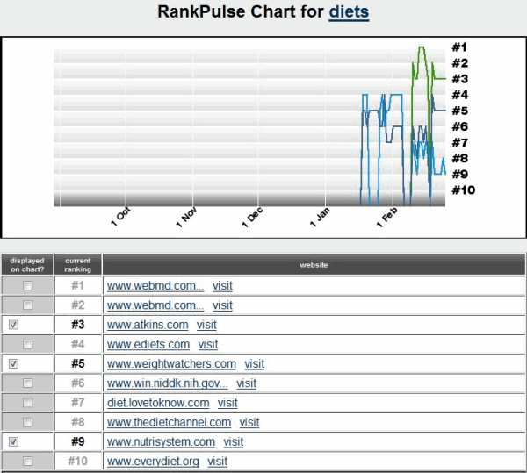
We Had Vince
Aaron Wall did some excellent analysis on Vince here: http://www.seobook.com/google-branding
Notes:
(Vince is also known as the ‘Florida Update’) Overnight, pages with repetitive, inbound anchor text with little diversity disappeared from the SERPs. So did those with heavy keyword phrase repetition on page and in page titles. Same for sites where the keyword phrases are clumped together and there’s no natural dispersion of the usage. And most exciting (for me) pages with a lack of rich conversation around the subject matter – those lacking related and supporting vocabulary – also lost rank in a hurry!

Slide 33
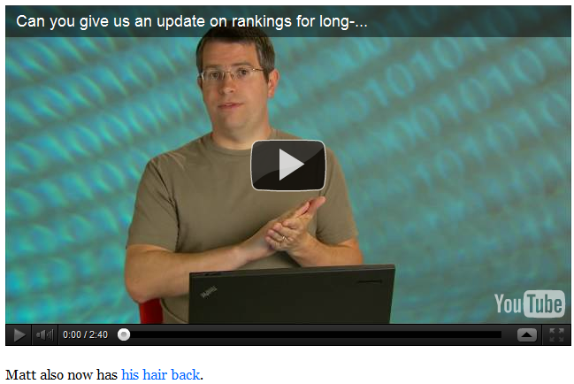
And May Day
Barry Schwartz summarized the impact as described by Matt here: http://www.seroundtable.com/archives/022293.html
Notes:
…which affected ‘fat belly’ or ‘long tail’ search results. In ‘09, there were about 550 updates to the algo – more than 1 a day!

Slide 34
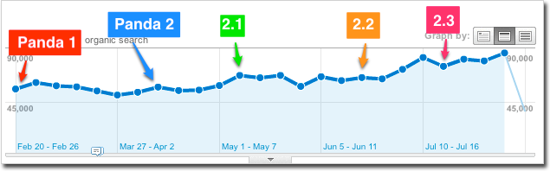
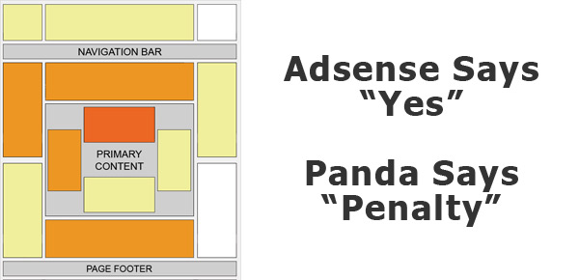
And, of Course, Panda
Some good analysis from Cyrus Shephard here: http://www.seomoz.org/blog/beat-google-panda
Notes:
Panda starts off with human quality raters who look at hundreds of websites. Using machine learning, computers mimic the human raters. When the algorithm becomes accurate enough to predict what the humans scored, it’s unleashed across millions of sites across the Internet. The result is super exciting.

Slide 35
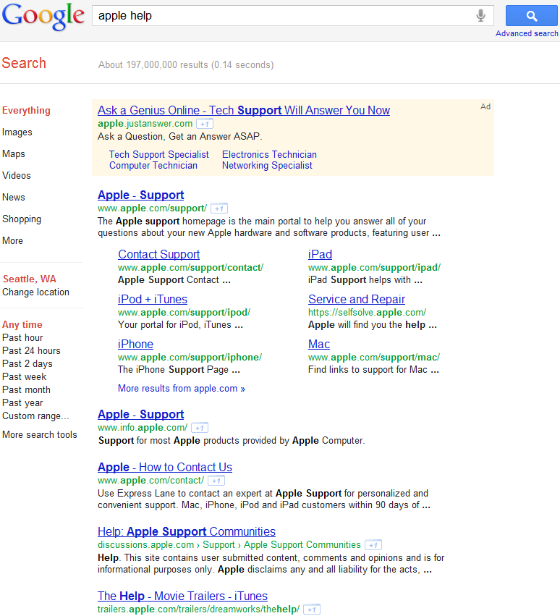
Brands Can Now Dominate Entire Pages
Nothing but Apple.com from top to bottom

Slide 36
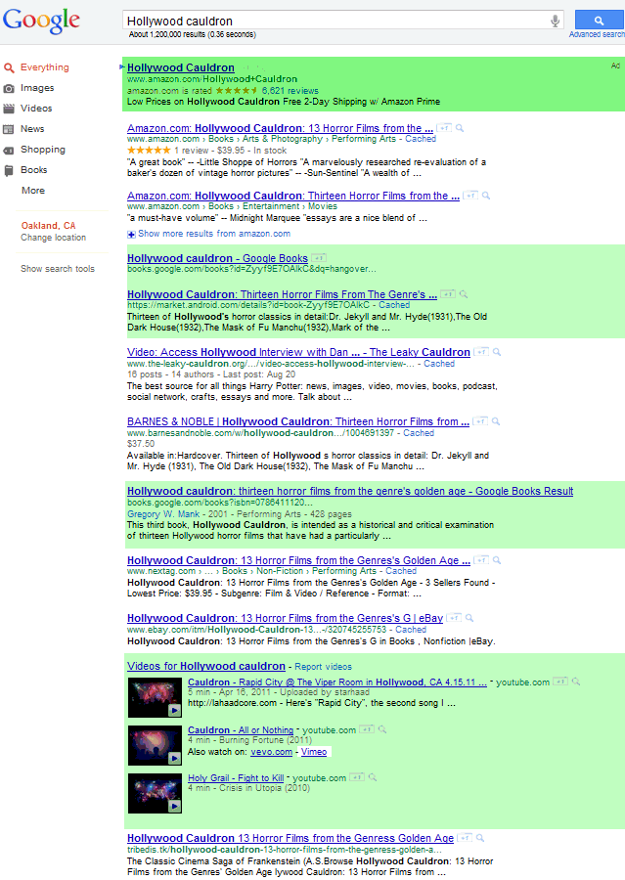
Some are Dominated by Google Itself
http://www.seobook.com/google-eats-their-organic-search-results
Notes:
Google was a search engine. Now Google is moving decisively toward becoming a collection of destination sites. This will present a conflict of interest about which some folks are already crying out. And which will soon be discussed in great detail by the US government.

Slide 37
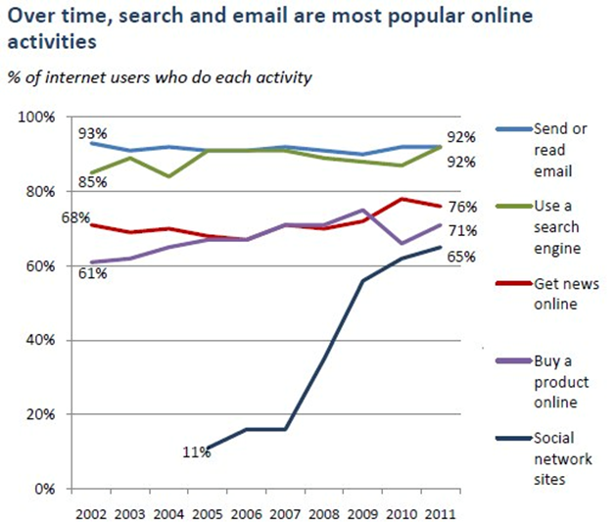
Social is on the Rise Like Never Before
Via http://searchengineland.com/top-internet-activities-search-email-once-again-88964
Notes:
Links don't divulge sentiment. They don't really tell you whether they are solid referrals or just a scammy attempt to make a page look important. Search results improved. But sentiment and immediacy was still an issue. Old links are good - it means you've been acknowledged as important to someone or something for awhile. But are you important TODAY? Social media signals tell you that.

Slide 38
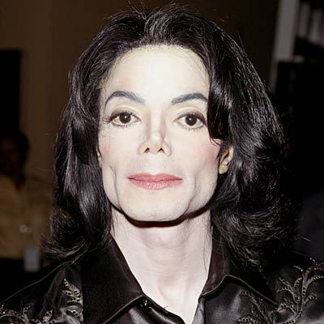
Why Social Signals Trump Links
Via http://www.michael-jackson-photos.com/
Notes:
Links don't divulge sentiment. They don't really tell you whether they are solid referrals or just a scammy attempt to make a page look important. Search results improved. But sentiment and immediacy was still an issue. Old links are good - it means you've been acknowledged as important to someone or something for awhile. But are you important TODAY? Social media signals tell you that.
When Michael Jackson died, Twitter carried the news around the world in a matter of seconds. Google SERPs carried relevant results in 22 minutes. The radio and TV channels reported in about 1-10 hours. And the newspapers carried the news in the morning papers. It was evident who was the master of the news that day.

Slide 39

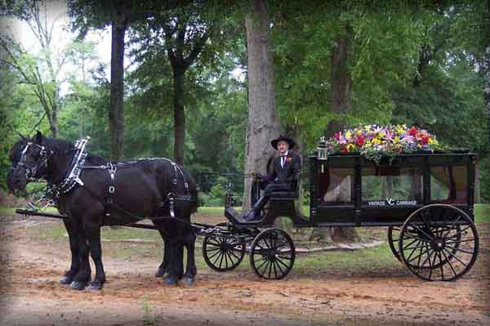

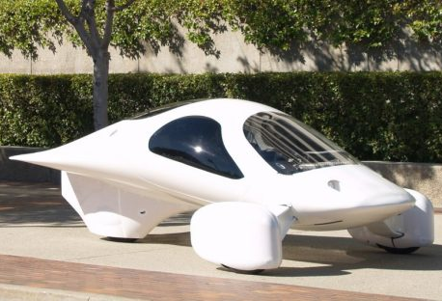
Why Social Signals Trump Links
Notes:
And that giant company, Google, with tens of thousands of employees and a major corporate infrastructure around it, did something almost no company on the planet can do. It pivoted in a matter of days. Within a few days, social media news, specifically Twitter feeds and Facebook comments were seen in the SERPs and they have been increasingly well integrated into the algorithm until today, we can no longer perform Search Marketing without paying attention to - and engaging in Social Media campaigns.

Slide 40









Social Fragmentation Appears Certain
Users:
50mm
750mm
200mm
120mm
10mm
Users:
14mm
Millions
14mm
6.5mm
This growth is a big reason why I’ve changed my tune on social media marketing and now strongly endorse it for almost every business: http://www.seomoz.org/blog/everyone-should-hire-social-media-experts
Notes:
Social fragmentation is already here. We’ll see a period of fragmentation, which we cannot ignore, and then a consolidation, just as we see the same patterns in offline industries. Look at the growth and development of the airline and phone service provider industries for good examples of patterns to watch

Slide 41
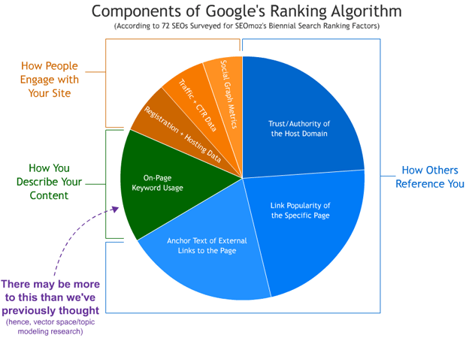
On Beyond Search!
http://www.seomoz.org/article/search-ranking-factors
Notes:
Remember the Panda updates? You didn’t think we just let that drop, did you? Last year, before SEOmoz published the 2011 Search Ranking Factors, The 'Moz team conducted some primary research on Latent Dirichlet Allocation, also known as LDA, LSI (latent semantic indexing), or topic modeling. The results were very exciting!

Slide 42

What’s Next…
http://www.seomoz.org/blog/lda-and-googles-rankings-well-correlated
Notes:
Remember the Panda updates? You didn’t think we just let that drop, did you?
Last year, before SEOmoz published the 2011 Search Ranking Factors, The 'Moz team conducted some primary research on Latent Dirichlet Allocation, also known as LDA, LSI (latent semantic indexing), or topic modeling. And the results were exciting!
At first, it appeared that the correlation between the LDA tool we built and search rankings was as much as .33 (with a 1.0 being a perfect correlation). After adjusting and perfecting the algorithms used to determine correlations, the numbers looked closer to .17, still an amazingly strong correlation. And then came the Panda Update…

Slide 43
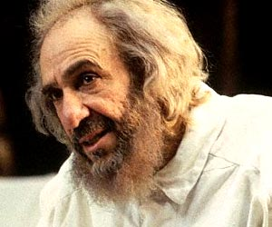
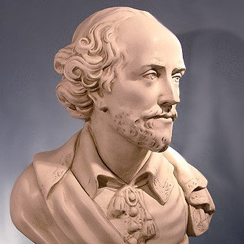
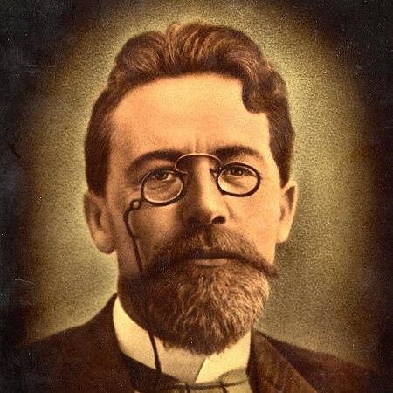
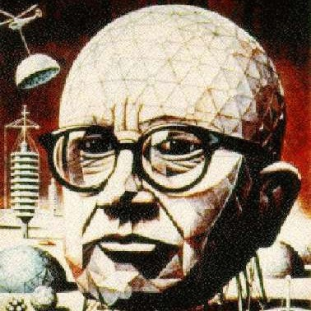
What Does It Mean?
Via: http://www.sjcalums.com/nyc/index.pl?page=famous_faces
Notes:
What does this mean to us as searchers and readers?
It means that Tolstoy wins! Chekov wins! Shakespeare! And R Buckminster Fuller.
Finally! Search engine algorithms are favoring websites with richly written content and demoting poorly written, spammy, duplicate, stolen, and thin content. As a searcher and reader, this is exciting news. It means that the search engines will cut out more junk from my daily search results and give me better, richer, higher quality things to read.

Slide 44
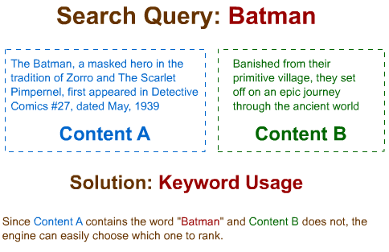
Keyword Usage
http://www.seomoz.org/blog/lda-and-googles-rankings-well-correlated
Notes:
Use of Keywords on the page - that's very old school, but I am always amazed at the number of people who think they can gun for the key phrase "Used Cars" without ever putting the words on the page!

Slide 45
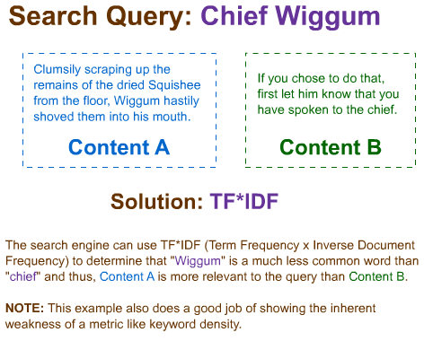
Term Frequency
Notes:
An understanding of Term Frequency/Inverse Document Frequency. If we're talking about the key phrase, "Chief Wiggum" spend more effort incorporating the word "Wiggum", which is an unusual words than the word "Chief", which is commonplace. This helps the search engine to understand what you're page is about and it helps readers by identifying the name of the character, rather than using pronouns. Did your mother admonish you when you were a child and referred to an adult as "she" instead of "Aunt Hilda"? My mother did. "She?', she would ask (pun intended). ;-) "SHE is the cat's mother! Use a person's name. She is disrespectful." Apparently, search engines think so, too.

Slide 46
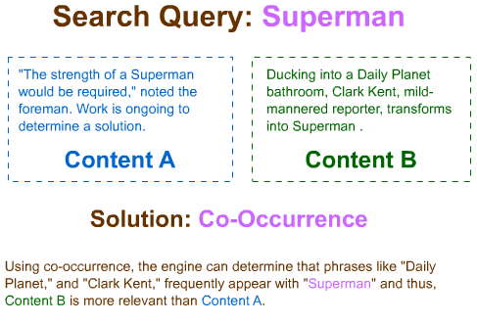
Co-Occurrence
Notes:
Co-Occurrence: Write more deeply about your subjects. If you're writing an article about Superman, use some context that lights up the imagination. "Ducking into the Daily Planet water closet, Clark Kent, mild mannered reporter, transforms into Superman" beats the heck out of "Clark Kent changes clothes to become Superman." Are you getting the idea?

Slide 47

What It Means to Us
Notes:
Topic Modeling And here things get really interesting. Consider these two snippets of content:
Content A: "Dropping his meeting note at the door, he jiggled the keys into the lock but found it wouldn't budge."
Content B: "Her hands mercilessly pounded the keys, notes cascading into the surrounding stairway."
While authors should be paying attention to the first rule of keyword usage, these authors were not concerned about that. Which of these pieces of content are about a piano? It takes us less than a few seconds to know that content B is about a piano. It takes us a few more moments to try to decide whether this is about a piano recital or just a passer by observing someone at the keyboard. In truth, the content doesn't tell us that. But we surely know that it's about a piano.

Slide 48

How Does a Search Engine Do That?
Rock or baseball?
Are you SURE?
http://www.seomoz.org/blog/lda-and-googles-rankings-well-correlated
Notes:
How does a search engine this? It looks at the neighborhood of words and deduces that the subject keyword, while un-named, is piano. Content A, on the other hand, is about having too many items in ones hands while trying unsuccessfully to open a door. Again, by the presence of some words and the absence of others, we - and now search engines - are able to deduce the intent of the author. Topic Modeling requires the ability to determine intent.

Slide 49

What It Means to Us
http://www.seomoz.org/blog/lda-and-googles-rankings-well-correlated
Notes:
The Panda update means that as marketers, we need to write richer, not just more detailed, copy for our websites. It means that search engines are favoring a richer, deeper conversations about a subject... Tolstoy wins! www.cialis-viagra-quick-mortgages.info loses. Hooray!

Slide 50

What’s More…

Slide 51

Search No Longer Works in a Vacuum
Earning a click in the SERPs is merely one step in a greater process.
Notes:
Search no longer works in a vacuum.

Slide 52

It Lives in the Broader Inbound Funnel
Eloqua’s content grid does a great job exploring where content sits in the marketing funnel: http://media.eloqua.com/images/The-Content-Grid-v2.jpg
Notes:
Earning a click is merely one step in the great game of inbound marketing. It’s no longer enough to be found in the SERPs… you need to be found everywhere.

Slide 53

But is Nearly Useless By Itself
Via http://www.seomoz.org/blog/tracking-the-roi-of-social-media
Notes:
The broader inbound funnel includes all the elements of the classic AIDA funnel (Awareness Interest, Desire and Action). It’s beautifully illustrated by Eloqua’s content grid. See it here: http://media.eloqua.com/images/The-Content-Grid-v2.jpg

Slide 54

SEO from 2001-2008

Slide 55

Make the Site Search-Engine Friendly
Via http://www.seomoz.org/blog/4-essential-seo-infographics

Slide 56

Target Keywords
Via http://www.seomoz.org/blog/perfecting-keyword-targeting-on-page-optimization

Slide 57

Build Links
Via http://opensiteexplorer.org

Slide 58

Good Enough
Yep; it really used to work.

Slide 59

That SEO
is Dead.

Slide 60

You Might Rank
Before you even do that, make sure you’re choosing the right goals: http://www.seomoz.org/blog/the-6-goals-of-seo-choosing-the-right-ones-for-your-business

Slide 61

You Probably Won’t Convert Well
Unless the rest of the funnel rocks, SEO is in a rough spot: http://www.seomoz.org/blog/winning-the-seo-battle-at-every-step-of-the-purchase-path
Notes:
Unless the rest of the funnel rocks. Work backwards. Follow the money backwards. Understand what people who convert are doing on your website and determine where folks who ‘fall off’ get lost. Choose the right goals for your business. One size does not fit everyone: http://www.seomoz.org/blog/the-6-goals-of-seo-choosing-the-right-ones-for-your-business. Make sure all the component of your sales funnel are operating at peak performance. You won’t rank well if your landing pages are irrelevant or poorly designed. High bounce rates negatively affect SERPs as well as waste conversion opportunities.

Slide 62



The New Look of Search
Notes:
Search has a whole new look.

Slide 63
Top Ten Tips to Kick Off
OptimizationCon Kharkiv!

Slide 64


#10: New Heirarchy of Social Credibility
Notes:
Over the coming months, you will hear more and more about social credibility. Just as PageRank gave way to MozRank and MozTrust as search engines looked for ways to determine the trustworthiness of a website, you will find companies creating tools to rank the value of Tweeters, Facebook users, and other social media personalities. They are ranking the value of tweets, and posts, based on the reach and depth of engagement of the personality (the person posting or tweeting).

Slide 65

#9: Info-graphics Are the New Linkbait
http://www.seomoz.org/blog/what-is-a-reverse-proxy-and-how-can-it-help-my-seo
Notes:
Focus on Data as content – share infographics, coalesce difficult ideas in graphic formats. It’s the new linkbait.

Slide 66

#8: Video Rules!
http://www.seomoz.org/blog/what-is-a-reverse-proxy-and-how-can-it-help-my-seo
Notes:
Video rules! More people click on video results regardless of whether they are 1st, 2nd, 3rd or 4th in the search results. Video provides us more info than words or pictures and they’re not going away. But with so few marketers leveraging them, you still have an opportunity to win big here. Also use video in your on-site conversion process. Are you selling a product? Replace the product image with a how-to-use-it video and watch your conversion rates. Grab a bottle of champagne. You’re going to need it.

Slide 67

#7: Branding is Baaaaa-ack!
Notes:
Influence search through branding. Bigger brands have a better chance of being part of the Suggest Pack. Build your brand by increasing tweets, facebook, and other social mentions of your brand to increase your chances of being part of the Pack.

Slide 68
#6: Leverage All the Social Networks
Users:
50mm
750mm
200mm
120mm
10mm
Users:
14mm
Millions
14mm
6.5mm
Notes:
Leverage the social networks. Don’t be salesy – that’s just dumb. Get deeply involved in posting, sharing, and promoting via social platforms. Remember, social results are trumping other organic SERPs more and more. Social will drive your rankings and CTR. Good page design will take it from there – remember; nothing exists in a vacuum: it’s all connected.

Slide 69

#5: Recommend Sites to Searchers
Notes:
Even in Kharkiv, I can see what others think of the restaurants I’m considering… and I don’t even speak the language! …but I can translate it. ☺
Being active in social networks will also mean you’ll be there when those you’re connected to are searching while ‘logged in’. Personalized search means seeing what your friends are up to and what they’re thinking while you search. Create share-worthy content, share it socially, earn a rankings boost, get natural links because you’re more visible now, earn more social followers as a result, your network amplifies and extends your reach, more searchers are biased to see your stuff when they search, you win!

Slide 70


#4:Build Links With Your Social Followers
Notes:
Build links with your social followers. Check out Export.ly and and Klout, and read Wil Reynolds excellent post: http://www.seerinteractive.com/blog/using-twitter-and-backlinks-to-build-links/2011/07/28. Use vLookup in Excel with the LInkscape ® API to see if your social followers are linking to you. Read Will Critchlow’s how to post: http://www.distilled.net/blog/seo/getting-started-with-the-free-linkscape-api/

Slide 71


#3: Play Games!
http://www.dreamstime.com/royalty-free-stock-photo-beach-soccer-game-between-ukraine-and-russia-image21025805
Notes:
Attack Long Tail SEO via gamification. It’s all about points and levels – we want to complete our profiles, increase our standing, get to the next level.
Quora does an extremely effective job of luring us in and engaging us so we continue to build their property.
Also check it out these platforms to see how the ‘game’ is played: http://stackexchange.com, http://dribbble.com, and even SEOmoz’s own http://www.seomoz.org/q.

Slide 72

#2: Thought Leadership = CTR Bump
Notes:
Thought leadership. Whatever field you’re in, if you can provide better, deeper, more actionable info about your subject, you will become known as the thought leader in the industry. With your “public figure” icon photo beside your SERP result, you’ll happily get a much higher CTR than those ranking above you.

Slide 73

#1: Ask Rand; He’s Not Busy ;-)
Notes:
Leverage other thought leaders to build content for your own website. Here’s a good example: http://blog.folyo.me/post/10723370923/how-much-does-a-website-cost The concept is simple; identify leading influencers in your space, recruit them to contribute something small, such as one or just a few survey answers. Then aggregate and share the data. They’ll help it spread.

Slide 74

+1!: Follow the Money Backwards
Notes:
Work backwards. Follow the money backwards. Understand what people who convert are doing on your website and determine where folks who ‘fall off’ get lost. Choose the right goals for your business. One size does not fit everyone: http://www.seomoz.org/blog/the-6-goals-of-seo-choosing-the-right-ones-for-your-business. Make sure all the component of your sales funnel are operating at peak performance. You won’t rank well if your landing pages are irrelevant or poorly designed. Bounce rates affect SERPs as well as waste conversion opportunities.

Slide 75

SEO is Bigger than SEO

Slide 76

And We Have the Skills, Knowledge, Experience and Adaptability to Win.

Slide 77

Long Live SEO!
Notes:
SEO is not dead… long Live the King!

Slide 78
Thank you!
Roger sends his love:
Code: SEMKharkiv2011
Learn more: www.seomoz.org
Use the code: www.seomoz.org/signup
Gillian Muessig
Founding President SEOmoz | @SEOmom | gillian@seomoz.org

